Slide 1
CPT_S 415
Big Data
Clustering
Data clustering
Graph clustering

Slide 2
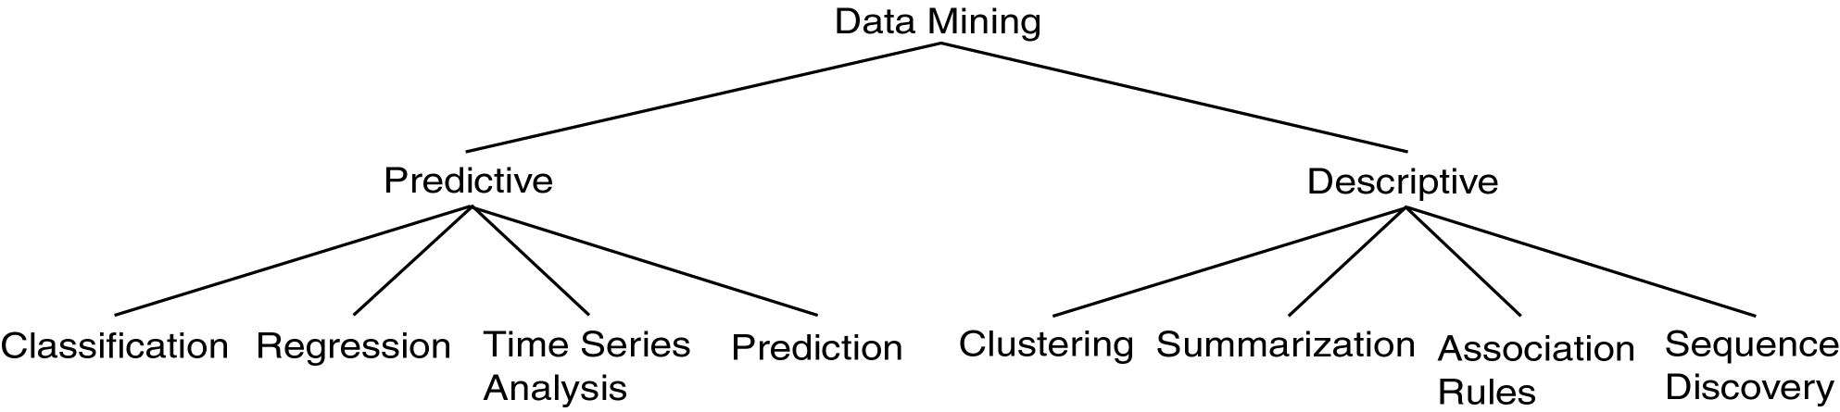
Data Mining Models and Tasks
  Use variables to predict unknown or future values of other variables.
  Find human-interpretable patterns that describe the data.

Slide 3
Data clustering

Slide 4
What is Cluster Analysis?
Cluster: A collection of data objects
  similar (or related) to one another within the same group
  dissimilar (or unrelated) to the objects in other groups
Cluster analysis (or clustering, data segmentation, …)
  Finding similarities between data according to the characteristics found in the data and grouping similar data objects into clusters
Unsupervised learning: no predefined classes (i.e., learning by observations vs. learning by examples: supervised)
Typical applications
  As a stand-alone tool to get insight into data distribution
  As a preprocessing step for other algorithms

Slide 5
Applications of Cluster Analysis
Data reduction
  Summarization: Preprocessing for regression, classification, and association analysis
  Compression: Image processing: vector quantization
Prediction based on groups
  Cluster & find characteristics/patterns for each group
Finding K-nearest Neighbors
  Localizing search to one or a small number of clusters
Outlier detection: Outliers are often viewed as those “far away” from any cluster

Slide 6
Clustering: Application Examples
Biology: taxonomy of living things: kingdom, phylum, class, order, family, genus and species
Land use: Identification of areas of similar land use in an earth observation database
Marketing: Help marketers discover distinct groups in their customer bases, and then use this knowledge to develop targeted marketing programs
City-planning: Identifying groups of houses according to their house type, value, and geographical location
Earth-quake studies: Observed earth quake epicenters should be clustered along continent faults
Climate: understanding earth climate, find patterns of atmospheric and ocean
Traffic flow analyses

Slide 7
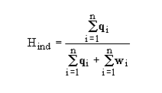
Basic Steps to Develop a Clustering Task
Feature selection
  Select info concerning the task of interest
  Minimal information redundancy
Proximity measure
  Similarity of two feature vectors
Clustering criterion
  Expressed via a cost function or some rules
Clustering algorithms
  Choice of algorithms
Validation of the results
  Validation test (also, clustering tendency test)
Interpretation of the results
  Integration with applications

Slide 8
What Is Good Clustering?
A good clustering method will produce high quality clusters
  high intra-class similarity: cohesive within clusters
  low inter-class similarity: distinctive between clusters
The quality of a clustering method depends on
  the similarity measure used by the method
  its implementation, and
  Its ability to discover some or all of the hidden patterns

Slide 9
Measure the Quality of Clustering
Dissimilarity/Similarity metric
  Similarity is expressed in terms of a distance function, typically metric: d(i, j)
  The definitions of distance functions are usually rather different for interval-scaled, Boolean, categorical, ordinal ratio, and vector variables
  Weights should be associated with different variables based on applications and data semantics
Quality of clustering:
  usually a separate “quality” function that measures the “goodness” of a cluster.
  It is hard to define “similar enough” or “good enough”
    The answer is typically highly subjective

Slide 10
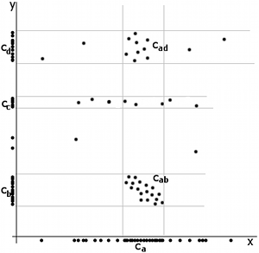
Considerations for Cluster Analysis
Partitioning criteria
  Single level vs. hierarchical partitioning (often, multi-level hierarchical partitioning is desirable)
Separation of clusters
  Exclusive (e.g., one customer belongs to only one region) vs. non-exclusive (e.g., one document may belong to more than one class)
Similarity measure
  Distance-based (e.g., Euclidian, road network, vector) vs. connectivity-based (e.g., density or contiguity)
Clustering space
  Full space (often when low dimensional) vs. subspaces (often in high-dimensional clustering)

Slide 11
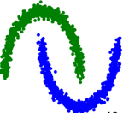
Requirements and Challenges
Scalability
  Clustering all the data instead of only on samples
Ability to deal with different types of attributes
  Numerical, binary, categorical, ordinal, linked, and mixture of these
Constraint-based clustering
    User may give inputs on constraints
    Use domain knowledge to determine input parameters
Interpretability and usability
Others
  Discovery of clusters with arbitrary shape
  Ability to deal with noisy data
  Incremental clustering and insensitivity to input order
  High dimensionality

Slide 12
Major Clustering Approaches (I)
Partitioning approach:
  Construct various partitions and then evaluate them by some criterion, e.g., minimizing the sum of square errors
  Typical methods: k-means, k-medoids
Hierarchical approach:
  Create a hierarchical decomposition of the set of data (or objects) using some criterion (agglomerative or divisive)
  Typical methods: Diana, Agnes, BIRCH, CAMELEON
Density-based approach:
  Based on connectivity and density functions
  Typical methods: DBSCAN, OPTICS, DenClue
Grid-based approach:
  based on a multiple-level granularity structure
  Typical methods: STING, WaveCluster, CLIQUE

Slide 13
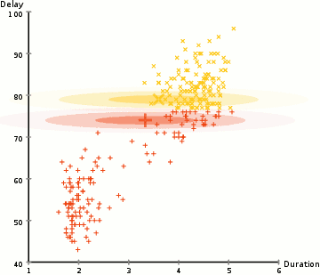
Major Clustering Approaches (II)
Model-based:
  A model is hypothesized for each of the clusters and tries to find the best fit of that model to each other
  Typical methods: EM, SOM, COBWEB
Frequent pattern-based:
  Based on the analysis of frequent patterns
  Typical methods: p-Cluster
User-guided or constraint-based:
  Clustering by considering user-specified or application-specific constraints
  Typical methods: COD (obstacles), constrained clustering
Link-based clustering:
  Objects are often linked together in various ways
  Massive links can be used to cluster objects: SimRank, LinkClus

Slide 14
Data clustering – Partition-based

Slide 15
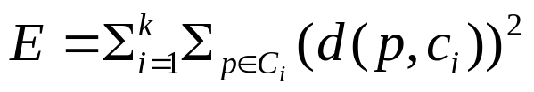
Partitioning Algorithms: Basic Concept
Partitioning method: Partitioning a database D of n objects into a set of k clusters, such that the sum of squared distances is minimized (where c_{i} is the centroid or medoid of cluster C_{i})
Given k, find a partition of k clusters that optimizes the chosen partitioning criterion
  Global optimal: exhaustively enumerate all partitions
  Heuristic methods: k-means and k-medoids algorithms
  k-means (MacQueen’67, Lloyd’57/’82): Each cluster is represented by the center of the cluster
  k-medoids or PAM (Partition around medoids) (Kaufman & Rousseeuw’87): Each cluster is represented by one of the objects in the cluster

Slide 16
The K-Means Clustering Method
Given k, the k-means algorithm is implemented in four steps:
  Partition objects into k nonempty subsets
  Compute seed points as the centroids of the clusters of the current partitioning (the centroid is the center, i.e., mean point, of the cluster)
  Assign each object to the cluster with the nearest seed point
  Go back to Step 2, stop when the assignment does not change

Slide 17
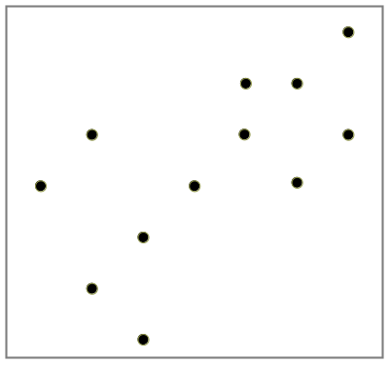

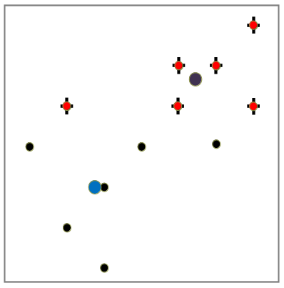
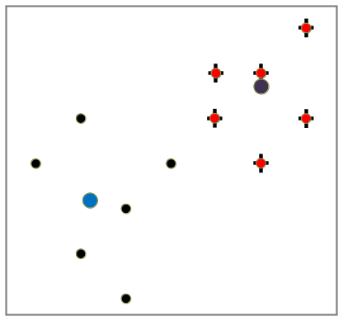

K-Means Clustering
K=2
Arbitrarily partition objects into k groups
Update the cluster centroids
The initial data set
Reassign objects
Loop if needed
Partition objects into k nonempty subsets
Repeat
  Compute centroid (i.e., mean point) for each partition
  Assign each object to the cluster of its nearest centroid
Until no change
Update the cluster centroids

Slide 18
What Is the Problem of the K-Means Method?
The k-means algorithm is sensitive to outliers !
  Since an object with an extremely large value may substantially distort the distribution of the data
K-Medoids: Instead of taking the mean value of the object in a cluster as a reference point, medoids can be used, which is the most centrally located object in a cluster
10
10
9
9
8
8
7
7
6
6
5
5
4
4
3
3
2
2
1
1
0
0
1
2
3
4
5
6
7
8
9
10
0
0
1
2
3
4
5
6
7
8
9
10

Slide 19
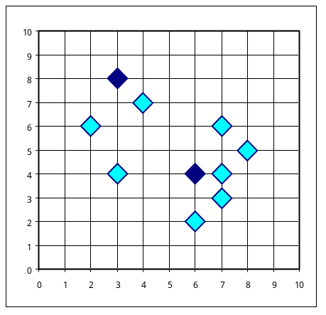

A Typical K-Medoids Algorithm
Total Cost = 20
10
9
8
Arbitrary choose k object as initial medoids
Assign each remaining object to nearest medoids
7
6
5
4
3
2
1
0
0
1
2
3
4
5
6
7
8
9
10
K=2
Randomly select a nonmedoid object,O_{ramdom}
Total Cost = 26
10
10
9
9
Do loop
Until no change
Swapping O and O_{ramdom}
If quality is improved.
8
8
7
Compute total cost of swapping
7
6
6
5
5
4
4
3
3
2
2
1
1
0
0
1
2
3
4
5
6
7
8
9
10
0
0
1
2
3
4
5
6
7
8
9
10

Slide 20
The K-Medoid Clustering Method
K-Medoids Clustering: Find representative objects (medoids) in clusters
  PAM (Partitioning Around Medoids, Kaufmann & Rousseeuw 1987)
    Starts from an initial set of medoids and iteratively replaces one of the medoids by one of the non-medoids if it improves the total distance of the resulting clustering
    PAM works effectively for small data sets, but does not scale well for large data sets (due to the computational complexity)
Efficiency improvement on PAM
  CLARA (Kaufmann & Rousseeuw, 1990): PAM on samples
  CLARANS (Ng & Han, 1994): Randomized re-sampling

Slide 21
Data clustering – Hierarchical methods

Slide 22
Hierarchical Clustering
Use distance matrix as clustering criteria. This method does not require the number of clusters k as an input, but needs a termination condition
Step 0
Step 1
Step 2
Step 3
Step 4
agglomerative
(AGNES)
a
a b
b
a b c d e
c
c d e
d
d e
e
divisive
(DIANA)
Step 4
Step 3
Step 2
Step 1
Step 0

Slide 23

AGNES (Agglomerative Nesting)
Introduced in Kaufmann and Rousseeuw (1990)
Implemented in statistical packages, e.g., Splus
Use the single-link method and the dissimilarity matrix
Merge nodes that have the least dissimilarity
Go on in a non-descending fashion
Eventually all nodes belong to the same cluster

Slide 24
DIANA (Divisive Analysis)
Introduced in Kaufmann and Rousseeuw (1990)
Implemented in statistical analysis packages, e.g., Splus
Inverse order of AGNES
Eventually each node forms a cluster on its own

Slide 25
Data clustering – Density-based methods

Slide 26
Density-Based Clustering Methods
Clustering based on density (local cluster criterion), such as density-connected points
Major features:
  Discover clusters of arbitrary shape
  Handle noise
  One scan
  Need density parameters as termination condition
Several interesting studies:
  DBSCAN: Ester, et al. (KDD’96)
  OPTICS: Ankerst, et al (SIGMOD’99).
  DENCLUE: Hinneburg & D. Keim (KDD’98)
  CLIQUE: Agrawal, et al. (SIGMOD’98) (more grid-based)

Slide 27
Density-Based Clustering: Basic Concepts
Two parameters:
  Eps: Maximum radius of the neighborhood
  MinPts: Minimum number of points in an Eps-neighborhood of that point
N_{Eps}(q): {p belongs to D | dist(p,q) ≤ Eps}
Directly density-reachable: A point p is directly density-reachable from a point q w.r.t. Eps, MinPts if
  p belongs to N_{Eps}(q)
  q is a core point:
  |N_{Eps} (q)| ≥ MinPts
p
MinPts = 5
Eps = 1 cm
q

Slide 28
Density-Reachable and Density-Connected
Density-reachable:
  A point p is density-reachable from a point q w.r.t. Eps, MinPts if there is a chain of points p₁, …, p_{n}, p₁ = q, p_{n} = p such that p_{i+1} is directly density-reachable from p_{i}
Density-connected
  A point p is density-connected to a point q w.r.t. Eps, MinPts if there is a point o such that both, p and q are density-reachable from o w.r.t. Eps and MinPts
p
p₁
q
p
q
o

Slide 29
DBSCAN: Density-Based Spatial Clustering of Applications with Noise
Relies on a density-based notion of cluster: A cluster is defined as a maximal set of density-connected points
Discovers clusters of arbitrary shape in spatial databases with noise
Outlier
Border
Eps = 1cm
MinPts = 5
Core

Slide 30



DBSCAN: Sensitive to Parameters
DBSCAN online Demo:
http://webdocs.cs.ualberta.ca/~yaling/Cluster/Applet/Code/Cluster.html

Slide 31
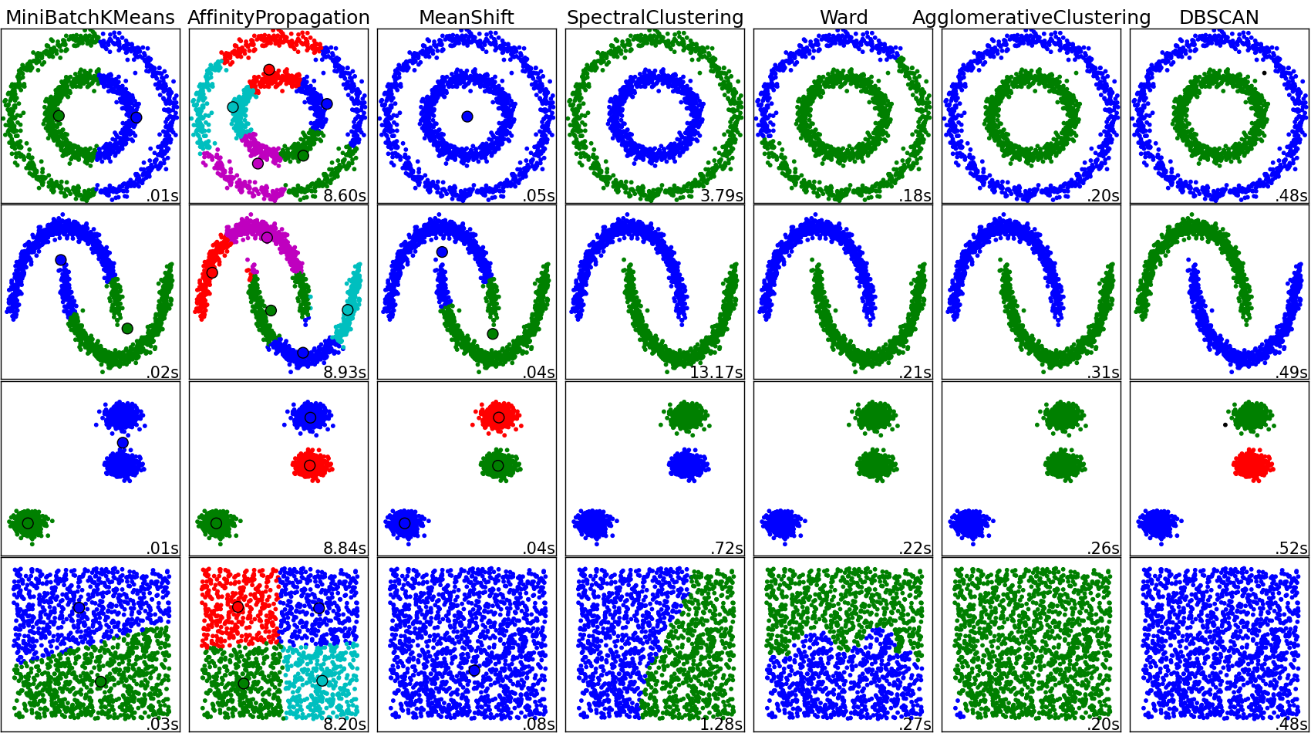
Comparing different clustering algorithms
A Density-Based Algorithm for Discovering Clusters in Large Spatial Databases with Noise, test of time Award, SIGKDD 14
DBSCAN Revisited:
Mis-Claim, Un-Fixability, and Approximation∗, Yufei Tao et.al, SIGMOD 15 best paper award

Slide 32
Data clustering – evaluation

Slide 33
Determine the Number of Clusters
Empirical method
  # of clusters: k ≈√n/2 for a dataset of n points, e.g., n = 200, k = 10
Elbow method
  Use the turning point in the curve of sum of within cluster variance w.r.t the # of clusters
Cross validation method
  Divide a given data set into m parts
  Use m – 1 parts to obtain a clustering model
  Use the remaining part to test the quality of the clustering
    E.g., For each point in the test set, find the closest centroid, and use the sum of squared distance between all points in the test set and the closest centroids to measure how well the model fits the test set
  For any k > 0, repeat it m times, compare the overall quality measure w.r.t. different k’s, and find # of clusters that fits the data the best

Slide 34
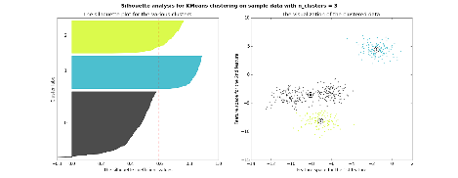
Measuring Clustering Quality
How do I know whether the clustering results are good?
3 kinds of measures: External, internal and relative
External: supervised, employ criteria not inherent to the dataset
  Compare a clustering against prior or expert-specified knowledge (i.e., the ground truth) using certain clustering quality measure
Internal: unsupervised, criteria derived from data itself
  Evaluate the goodness of a clustering by considering how well the clusters are separated, and how compact the clusters are, e.g., Silhouette coefficient
Relative: directly compare different clusterings, usually those obtained via different parameter settings for the same algorithm

Slide 35
Measuring Clustering Quality: External Methods
Clustering quality measure: Q(C, T), for a clustering C given the ground truth T
Q is good if it satisfies the following 4 essential criteria
  Cluster homogeneity: the purer, the better
  Cluster completeness: should assign objects belong to the same category in the ground truth to the same cluster
  Rag bag: putting a heterogeneous object into a pure cluster should be penalized more than putting it into a rag bag (i.e., “miscellaneous” or “other” category)
  Small cluster preservation: splitting a small category into pieces is more harmful than splitting a large category into pieces

Slide 36
Some Commonly Used External Measures
Matching-based measures
  Purity, maximum matching, F-measure
Entropy-Based Measures
  Conditional entropy, normalized mutual information (NMI), variation of information
Pair-wise measures
  Four possibilities: True positive (TP), FN, FP, TN
  Jaccard coefficient, Rand statistic, Fowlkes-Mallow measure
Correlation measures
  Discretized Huber static, normalized discretized Huber static
Ground truth partitioning T₁
T₂
Cluster C₁
Cluster C₂

Slide 37
Graph Clustering

Slide 38
Clustering Graphs and Network Data
Applications
  Bi-partite graphs, e.g., customers and products, authors and conferences
  Web search engines, e.g., click through graphs and Web graphs
  Social networks, friendship/coauthor graphs
Similarity measures
  Geodesic distances
  Distance based on random walk (SimRank)
Graph clustering methods
  Minimum cuts: FastModularity (Clauset, Newman & Moore, 2004)
  Density-based clustering: SCAN (Xu et al., KDD’2007)

Slide 39
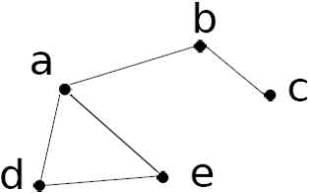
Similarity Measure (I): Geodesic Distance
Geodesic distance (A, B): length (i.e., # of edges) of the shortest path between A and B (if not connected, defined as infinite)
Eccentricity of v, eccen(v): The largest geodesic distance between v and any other vertex u ∈ V − {v}.
  E.g., eccen(a) = eccen(b) = 2; eccen(c) = eccen(d) = eccen(e) = 3
Radius of graph G: The minimum eccentricity of all vertices, i.e., the distance between the “most central point” and the “farthest border”
  r = min _{v∈V} eccen(v)
  E.g., radius (g) = 2
Diameter of graph G: The maximum eccentricity of all vertices, i.e., the largest distance between any pair of vertices in G
  d = max _{v∈V} eccen(v)
  E.g., diameter (g) = 3
A peripheral vertex is a vertex that achieves the diameter.
  E.g., Vertices c, d, and e are peripheral vertices

Slide 40
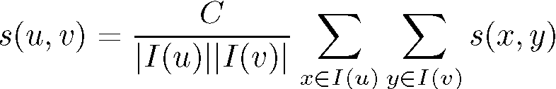





SimRank: Similarity Based on Random Walk and Structural Context
SimRank: structural-context similarity, i.e., based on the similarity of its neighbors
In a directed graph G = (V,E),
  individual in-neighborhood of v: I(v) = {u | (u, v) ∈ E}
  individual out-neighborhood of v: O(v) = {w | (v, w) ∈ E}
Similarity in SimRank:
  Initialization:
  Then we can compute s_{i+1} from s_{i} based on the definition
Similarity based on random walk: in a strongly connected component
  Expected distance:
  Expected meeting distance:
  Expected meeting probability:
P[t]: probability of the tour

Slide 41
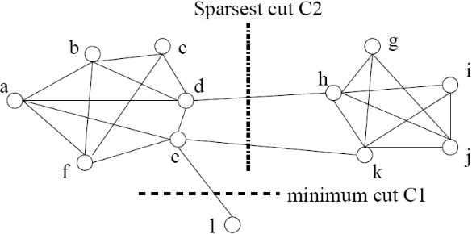
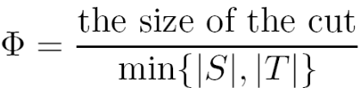
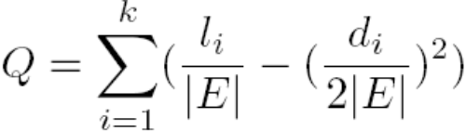
Graph Clustering: Sparsest Cut
G = (V,E). The cut set of a cut is the set of edges {(u, v) ∈ E | u ∈ S, v ∈ T } and S and T are in two partitions
Size of the cut: # of edges in the cut set
Min-cut (e.g., C₁) is not a good partition
A better measure: Sparsity:
l_{i}: # edges between vertices in the i-th cluster
d_{i}: the sum of the degrees of the vertices in the i-th cluster
A cut is sparsest if its sparsity is not greater than that of any other cut
Ex. Cut C2 = ({a, b, c, d, e, f, l}, {g, h, i, j, k}) is the sparsest cut
For k clusters, the modularity of a clustering assesses the quality of the clustering:
The modularity of a clustering of a graph is the difference between the fraction of all edges that fall into individual clusters and the fraction that would do so if the graph vertices were randomly connected

Slide 42
Graph Clustering: Challenges of Finding Good Cuts
High computational cost
  Many graph cut problems are computationally expensive
  The sparsest cut problem is NP-hard
  Need to tradeoff between efficiency/scalability and quality
High dimensionality
  A graph can have many vertices. In a similarity matrix, a vertex is represented as a vector (a row in the matrix) whose dimensionality is the number of vertices in the graph
Sparsity
  A large graph is often sparse, meaning each vertex on average connects to only a small number of other vertices
  A similarity matrix from a large sparse graph can also be sparse

Slide 43
Two Approaches for Graph Clustering
Two approaches for clustering graph data
  Use generic clustering methods for high-dimensional data
  Designed specifically for clustering graphs
Using clustering methods for high-dimensional data
  Extract a similarity matrix from a graph using a similarity measure
  A generic clustering method can then be applied on the similarity matrix to discover clusters
  Spectral clustering methods: approximate optimal graph cuts
Methods specific to graphs
  Search the graph to find well-connected components as clusters
  Ex. SCAN (Structural Clustering Algorithm for Networks)
    X. Xu, N. Yuruk, Z. Feng, and T. A. J. Schweiger, “SCAN: A Structural Clustering Algorithm for Networks”, KDD'07

Slide 44
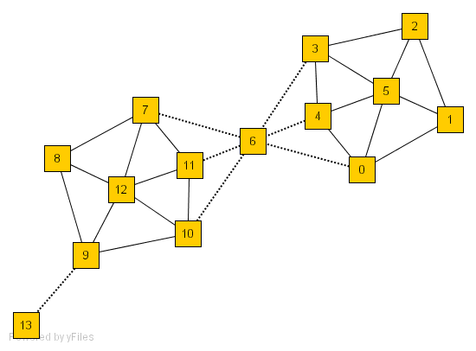
SCAN: Density-Based Clustering of Networks
How many clusters?
What size should they be?
What is the best partitioning?
Should some points be segregated?
An Example Network
Application: Given simply information of who associates with whom, could one identify clusters of individuals with common interests or special relationships (families, cliques, terrorist cells)?

Slide 45
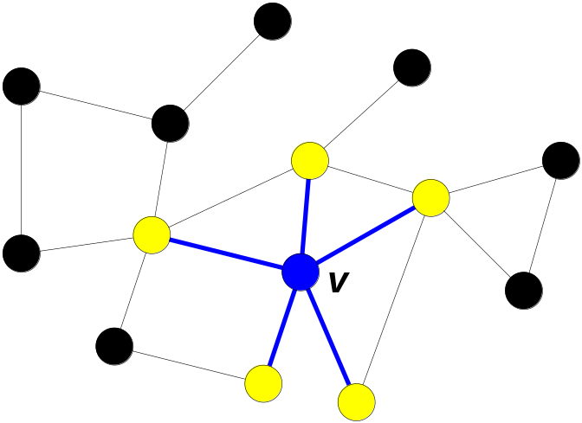
A Social Network Model
Cliques, hubs and outliers
  Individuals in a tight social group, or clique, know many of the same people, regardless of the size of the group
  Individuals who are hubs know many people in different groups but belong to no single group. Politicians, for example bridge multiple groups
  Individuals who are outliers reside at the margins of society. Hermits, for example, know few people and belong to no group
The Neighborhood of a Vertex
  Define Γ(ν) as the immediate neighborhood of a vertex (i.e. the set of people that an individual knows )

Slide 46
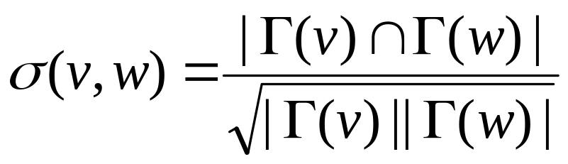
Structure Similarity
The desired features tend to be captured by a measure we call Structural Similarity
Structural similarity is large for members of a clique and small for hubs and outliers

Slide 47


Structural Connectivity [1]
ε-Neighborhood:
Core:
Direct structure reachable:
Structure reachable: transitive closure of direct structure reachability
Structure connected:
[1] M. Ester, H. P. Kriegel, J. Sander, & X. Xu (KDD'96) “A Density-Based Algorithm for Discovering Clusters in Large Spatial Databases

Slide 48

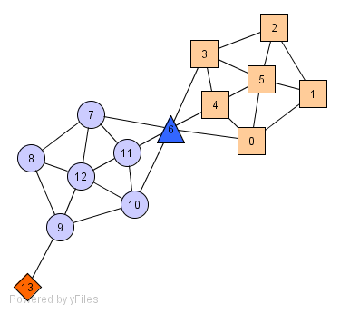
Structure-Connected Clusters
Structure-connected cluster C
  Connectivity:
  Maximality:
Hubs:
  Not belong to any cluster
  Bridge to many clusters
Outliers:
  Not belong to any cluster
  Connect to less clusters
hub
outlier

Slide 49
Algorithm
2
μ = 2
ε = 0.7
3
5
4
1
7
6
0
8
11
12
10
9
13

Slide 50
Algorithm
2
μ = 2
ε = 0.7
3
5
1
4
7
6
0
8
11
12
10
9
0.63
13

Slide 51
Algorithm
2
3
μ = 2
ε = 0.7
5
1
4
7
0.67
6
0
8
11
0.82
12
0.75
10
9
13

Slide 52
Algorithm
2
3
μ = 2
ε = 0.7
5
1
4
7
6
0
8
11
12
10
9
13

Slide 53
Algorithm
2
3
μ = 2
ε = 0.7
5
1
4
7
6
0
8
11
12
10
9
0.67
13

Slide 54
Algorithm
2
3
μ = 2
ε = 0.7
5
1
4
7
6
0
8
0.73
11
12
0.73
0.73
10
9
13

Slide 55
Algorithm
2
3
μ = 2
ε = 0.7
5
1
4
7
6
0
8
11
12
10
9
13

Slide 56
Algorithm
2
3
μ = 2
ε = 0.7
5
1
4
7
0.51
6
0
8
11
12
10
9
13

Slide 57
Algorithm
2
3
μ = 2
ε = 0.7
5
1
4
7
6
0
11
0.68
8
12
10
9
13

Slide 58
Algorithm
2
3
μ = 2
ε = 0.7
5
1
4
7
6
0
8
11
12
0.51
10
9
13

Slide 59
Algorithm
2
3
μ = 2
ε = 0.7
5
1
4
7
6
0
8
11
12
10
9
13

Slide 60
Algorithm
2
3
μ = 2
ε = 0.7
5
0.51
1
4
7
0.68
6
0
11
0.51
8
12
10
9
13

Slide 61
Algorithm
2
3
μ = 2
ε = 0.7
5
1
4
7
6
0
8
11
12
10
9
13

Slide 62
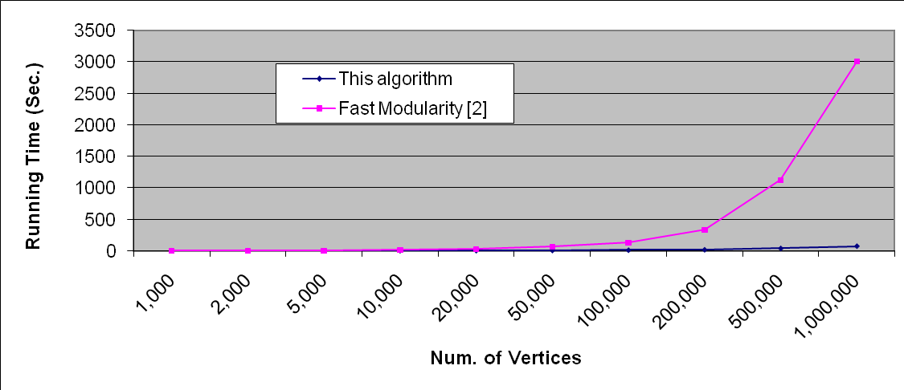
Running Time
Running time = O(|E|)
For sparse networks = O(|V|)
[2] A. Clauset, M. E. J. Newman, & C. Moore, Phys. Rev. E 70, 066111 (2004).

Slide 63
Summary
Cluster analysis groups objects based on their similarity and has wide applications
Measure of similarity can be computed for various types of data
Clustering algorithms can be categorized into partitioning methods, hierarchical methods, density-based methods, grid-based methods, and model-based methods
K-means and K-medoids algorithms are popular partitioning-based algorithms
AGNES and Diana are interesting hierarchical clustering algorithms, and there are also probabilistic hierarchical clustering algorithms
DBSCAN, OPTICS, and DENCLU are interesting density-based algorithms
Quality of clustering results can be evaluated in various ways
Graph Clustering:
  min-cut vs. sparsest cut
  High-dimensional clustering methods
  Graph-specific clustering methods, e.g., SCAN

Slide 64
Papers to read
S. Arora, S. Rao, and U. Vazirani. Expander flows, geometric embeddings and graph partitioning. J. ACM, 56:5:1–5:37, 2009.
I. Davidson and S. S. Ravi. Clustering with constraints: Feasibility issues and the k-means algorithm. SDM’05
I. Davidson, K. L. Wagstaff, and S. Basu. Measuring constraint-set utility for partitional clustering algorithms. PKDD’06
C. Fraley and A. E. Raftery. Model-based clustering, discriminant analysis, and density estimation. J. American Stat. Assoc., 97:611–631, 2002.
G. Jeh and J. Widom. SimRank: a measure of structural-context similarity. KDD’02
H.-P. Kriegel, P. Kroeger, and A. Zimek. Clustering high dimensional data: A survey on subspace clustering, pattern-based clustering, and correlation clustering. ACM Trans. Knowledge Discovery from Data (TKDD), 3, 2009.

Slide 65
Papers to read
A. Y. Ng, M. I. Jordan, and Y. Weiss. On spectral clustering: Analysis and an algorithm. NIPS’01
J. Pei, X. Zhang, M. Cho, H. Wang, and P. S. Yu. Maple: A fast algorithm for maximal pattern-based clustering. ICDM’03
M. Radovanovi´c, A. Nanopoulos, and M. Ivanovi´c. Nearest neighbors in high-dimensional data: the emergence and influence of hubs. ICML’09
S. E. Schaeffer. Graph clustering. Computer Science Review, 1:27–64, 2007.
A. K. H. Tung, J. Han, L. V. S. Lakshmanan, and R. T. Ng. Constraint-based clustering in large databases. ICDT’01
A. Tanay, R. Sharan, and R. Shamir. Biclustering algorithms: A survey. In Handbook of Computational Molecular Biology, Chapman & Hall, 2004.
H. Wang, W. Wang, J. Yang, and P. S. Yu. Clustering by pattern similarity in large data sets. SIGMOD’02
X. Xu, N. Yuruk, Z. Feng, and T. A. J. Schweiger. SCAN: A structural clustering algorithm for networks. KDD’07

